Slide 1
DRONE BASED 3D TERRAIN MAPPING
DSA 0201 – Computer Vision with open cv
Presented by:
K. Madhulika

Slide 2
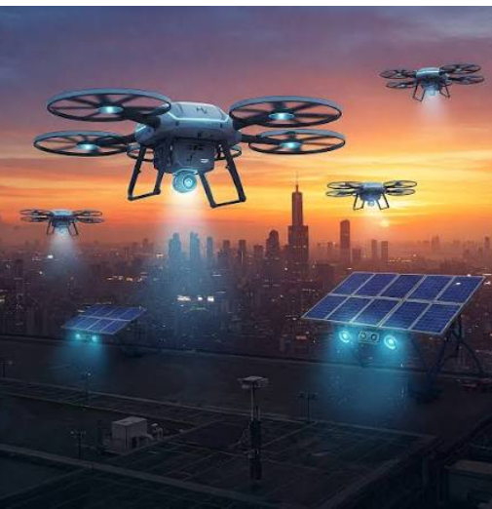
Introduction
Drone-based mapping uses drones equipped with cameras to capture aerial images of an area.
These images are processed to create accurate 2D maps and 3D terrain models.
Multiple overlapping images are captured from different viewpoints during the drone's flight.
The generated 3D models help in measuring elevation, distance, and terrain features accurately.

Slide 3
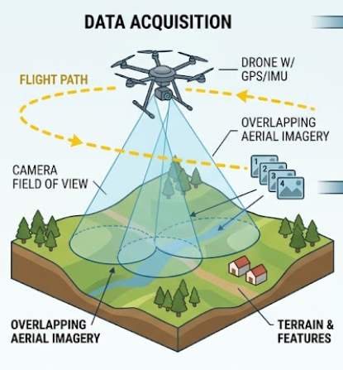
Image Formation
Image Formation is the process by which light reflected from objects passes through the camera lens and is captured by the image sensor to produce a digital image.
The drone camera captures light reflected from the terrain.
The camera lens focuses the light onto the image sensor.
The image sensor converts light into digital data.

Slide 4
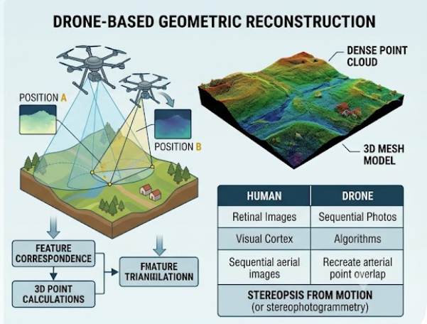
Binocular Vision
Binocular Vision is the ability to estimate the depth and distance of objects by comparing two images captured from slightly different viewpoints, similar to how human eyes perceive depth.
Uses two images (left and right views) of the same scene.
Measures the disparity (difference in object position) between the two images.
Helps drones understand the 3D structure of the environment.

Slide 5
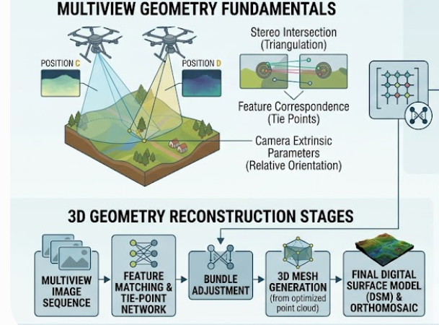
Multi-View Geometry
Multi-View Geometry is a computer vision technique that reconstructs a 3D scene by analysing multiple images of the same object or terrain captured from different viewpoints.
Uses multiple overlapping images captured by the drone.
Identifies and matches common feature points across images.
Calculates the 3D coordinates of objects and terrain.

Slide 6
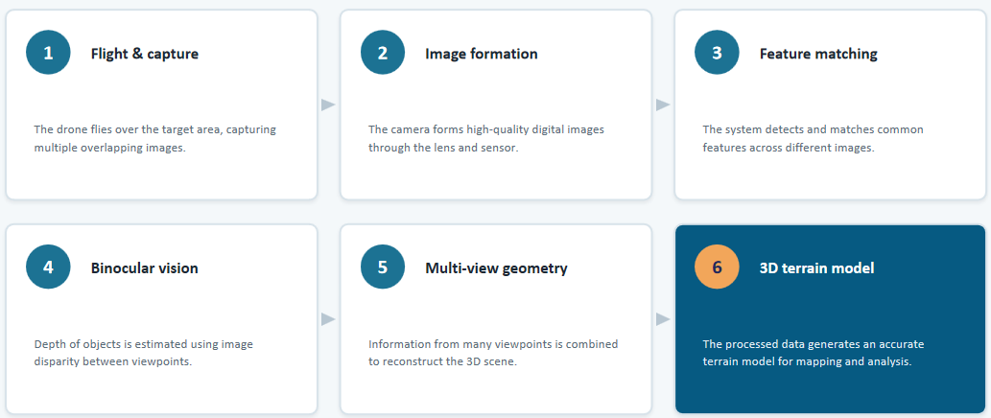
How a Drone Creates a 3D Terrain Model

Slide 7


